Slide 1
Data 824 Final Project
Andy Draper
July 23rd, 2024

Slide 2
Dataset
This shiny app uses the `dataCar` dataset from the `insuranceData` package.
The insurance data contains information on 60k+ policy terms.
Each record contains the number of claims and the amount of claims for that policy term, along with a few explanatory variables.
Most of the policy terms do not have claims (numclaims = 0).
We decided to focus this data exploration only on the severity of the claims (severity = claimcst0 / numclaims). There are 4,624 observations with numclaims > 0.

Slide 3
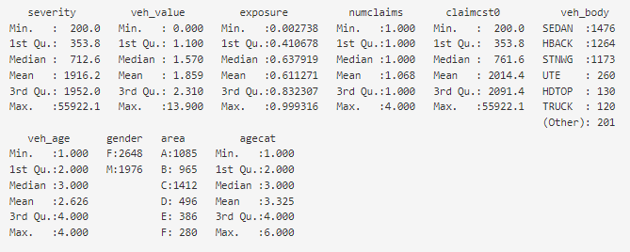
Summary of the Data
Here is the R summary of the data

Slide 4
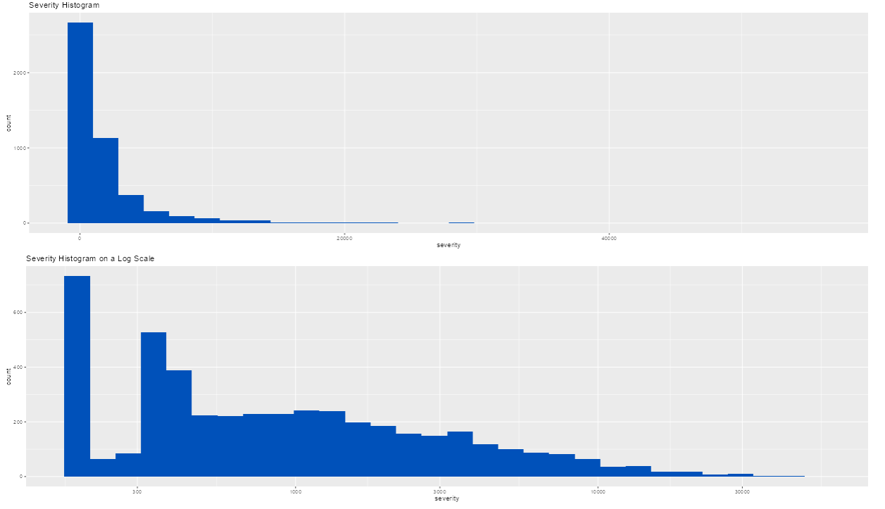
Response Variable
We chose to focus the modeling the claim severities. Here are the histograms of severity and log(severity).

Slide 5
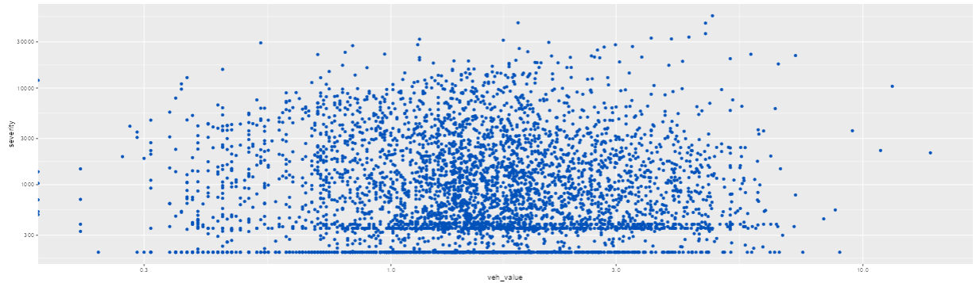
Sample Variable Plots
The shiny app includes one-way variable plots for most of the variables. Here is the chart of severity vs veh_value
A couple insights:
There are some veh_values of $0, which appear to be dirty data.
There appear to be a lot of claims clustered at severities around $100 and $300

Slide 6
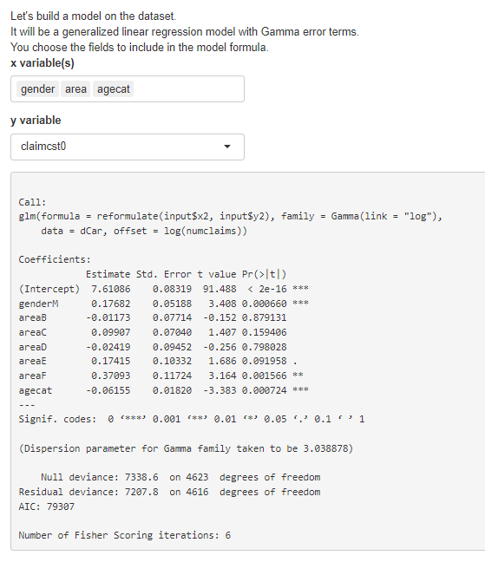
Dynamic Model
The power of the shiny platform is user interaction. This particular dashboard allows the user to select individual fields to include in a glm model.
Here we show the model summary for one particular model that was tried.

Slide 7
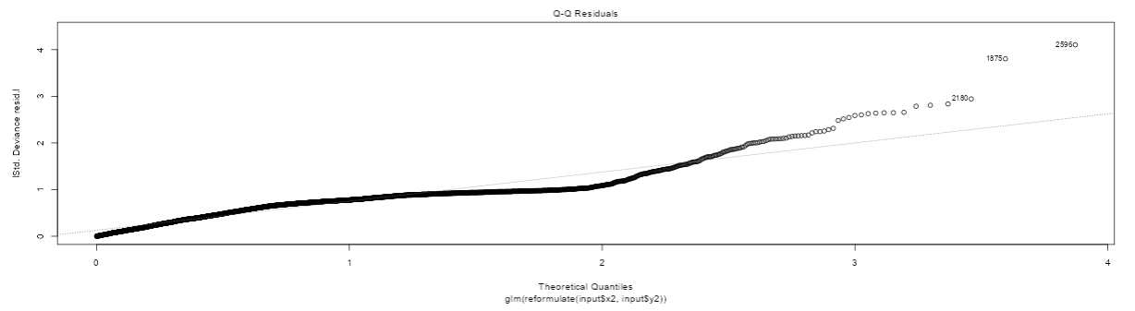
Insight / Conclusion
We tried a number of models with various predictor variables. The model shown on the last tab appears to be the best candidate model.
We review the diagnostic plots and show the qq-plot here.
Insurance data is very skewed. We modeled the data with a Gamma GLM. The qq-plot even then does not fit the data great, but this might be the best model we can do with this data.

Slide 8
Sharing and Feedback
The shiny app is located at the git repo here:
adraper1/824_final_project (github.com)

